Slide 1
NESDIS S-NPP and JPSS Product Availability
Tom Schott
NESDIS Office of Systems Development Satellite Product Manager
18 Nov 2014

Slide 2
Outline
JPSS ground system overview
Access to JPSS data and challenges making near real time data available to users
JPSS data products

Slide 3
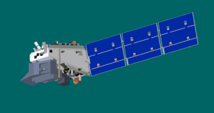
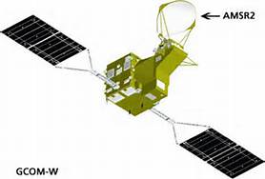
System Description (Ground System)
NOAA Archive
Mission Data
KSAT (Svalbard)
S-NPP
Numerical Weather Prediction Centers
NPP Data Exploitation (NDE)
Interface Data Processor (NOAA)
National Weather Service Field Offices
Mission Management Center (MMC)
GCOM-W1
GCOM-W Processing and Distribution System (GPDS)
National Ocean Service
Command, Control and Communications Segment (C3S)
Interface Data Processing Segment (IDPS)
National Marine Fisheries Service
Environmental Satellite Processing Center (ESPC)
Common Ground System
Other Users
3
Other Satellites (GOES, POES, Jason)

Slide 4
Near Real Time S-NPP Data
NESDIS’s NPP Data Exploitation (NDE) Project
Serves the near real time user community
Access to S-NPP SDRs, EDRs and NESDIS Unique Products (NUPS) with tailoring options
FTPS protocol per RFC 4217 (encrypted control, unencrypted data), push and pull
Preparing a remote backup operational capability at Fairmont, WV in 2016
Users must submit S-NPP Data Access Request (DAR) Form to NESDIS.Data.Access@noaa.gov
Requests involving large data volumes will require the user to establish a communication capability to access data

Slide 5
Near Real Time S-NPP Data (cont.)
Global Telecommunications Service (GTS) & European Organisation for the Exploitation of Meteorological Satellite (EUMETSAT)
EUMETSAT redistributes NDE delivered CrIS and ATMS radiance sensor data records in BUFR format on GTS and EUMETCast
GTS is used for operational international exchange of meteorological data between National Centers
EUMETCast is a satellite multicast system using DVB-S technology. Users register for access via EUMETSAT

Slide 6
Archived S-NPP Data
NOAA’s archive system: Comprehensive Large Array-data Stewardship System (CLASS, http://www.class.noaa.gov/)
JPSS ground system (IDPS) data delayed by 6 hours or more and normally made available to users within 24 hours
NDE’s NUP data made available when produced
CLASS provides a subscription service
See BLOG provided by SPoRT http://nasasport.wordpress.com/2014/10/30/near-real-time-s-npp-data-via-noaa-class-subscription-service/)
6

Slide 7
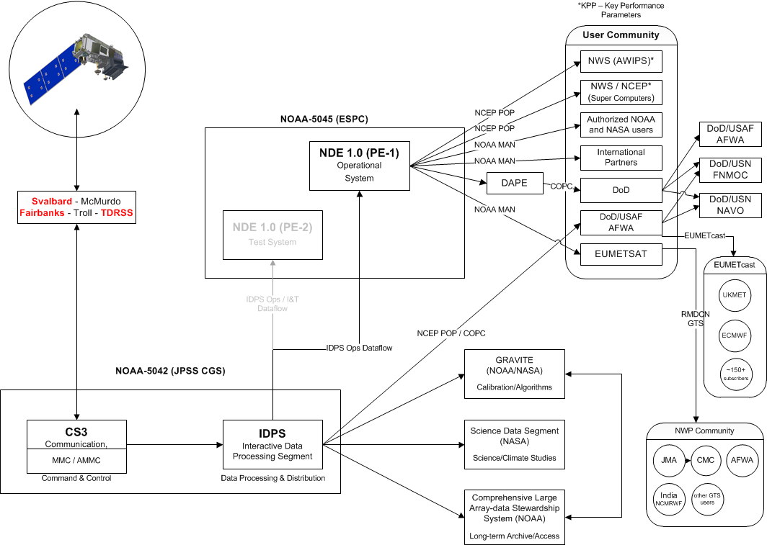
Current JPSS Data Flow

Slide 8
Upgrade to
10G FY15/Q1
Saturate WWW
access capability
External internet traffic to STAR and other authorized partners.
NCEP, NWS & DOD
Does not include IDPS AFWA connection
OSPO/SPSD
10G example

Slide 9
Driving Requirements NOAA Near-Real Time Priorities
Red = Key Performance Parameter
Blue = NUP Product
Black = IDPS Product
Critical
Supplemental High
Supplemental Low
RDR and SDR:
OMPS-LP
EDRs:
EDRs:
ATMS
Land Surface Temperature
Moisture Profile
Temperature Profile
CrIS
Trace Gases (CO, CO2, CH4)
VIIRS
Aerosol Particle Size
Vegetation Index
Land Surface Type
Land Surface Temperature
Surface Albedo
Atmospheric Pressure Profile
Cloud Top Temperature
Cloud Top Pressure
Cloud Base Height
Ice Surface Temperature
Quarterly Surface Type
Vegetation Health Product Suite
AMSR-2
Surface Type
TDR and SDR:
CrIS ATMS AMSR-2/3
VIIRS CERES OMPS-NP
EDRs:
VIIRS
Imagery EDR
Sea Surface Temperature
Ocean Color/Chlorophyll
Green Vegetation Fraction
Polar Winds
ATMS
Land Surface Emissivity
AMSR-2
Sea Surface Temperature
CrIS/ATMS
Atmospheric Temperature
Profile
Atmospheric Moisture Profile
ATMS
Imagery
Cloud Liquid Water
Rainfall Rate
Sea Ice Concentration
Snow Cover
Snow Water Equivalent
Total Precipitable Water
OMPS Nadir and Limb
Nadir Ozone Profile
Ozone Total Column
Ozone Limb Profile
VIIRS
Sea Ice Characterization
Snow Cover
Active Fires
Suspended Matter
Cloud Cover/Layers
Cloud Mask
Cloud Effective Particle Size
Cloud Optical Thickness
Cloud Top Height
Aerosol Optical Thickness
AMSR-2
Sea Surface Wind Speed
Sea Ice Characterization
Precipitable Water
Soil Moisture
Precipitation Type/Rate
Snow Cover/Depth
Snow Water Equivalent
CrIS
Infrared Ozone Profile
Outgoing Longwave Radiation

Slide 10
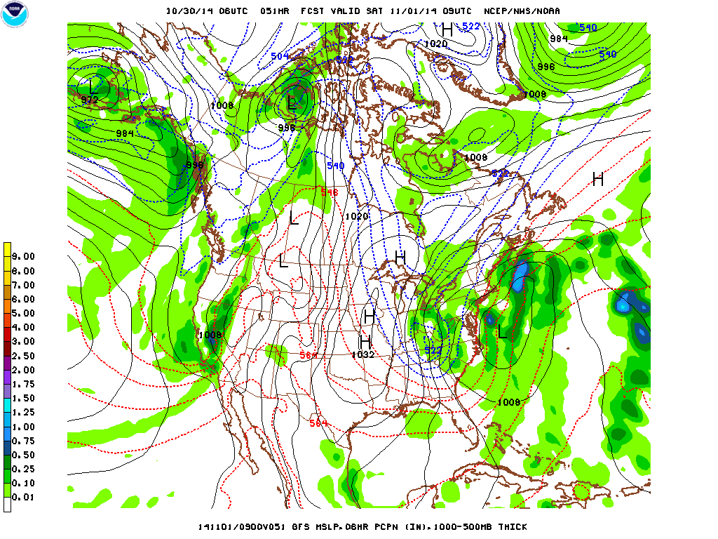
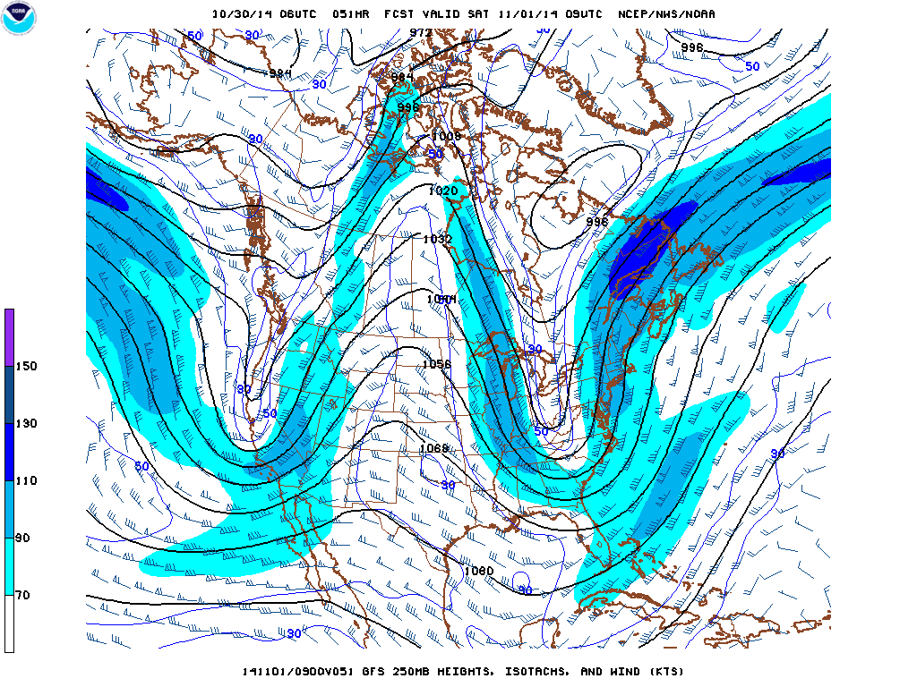
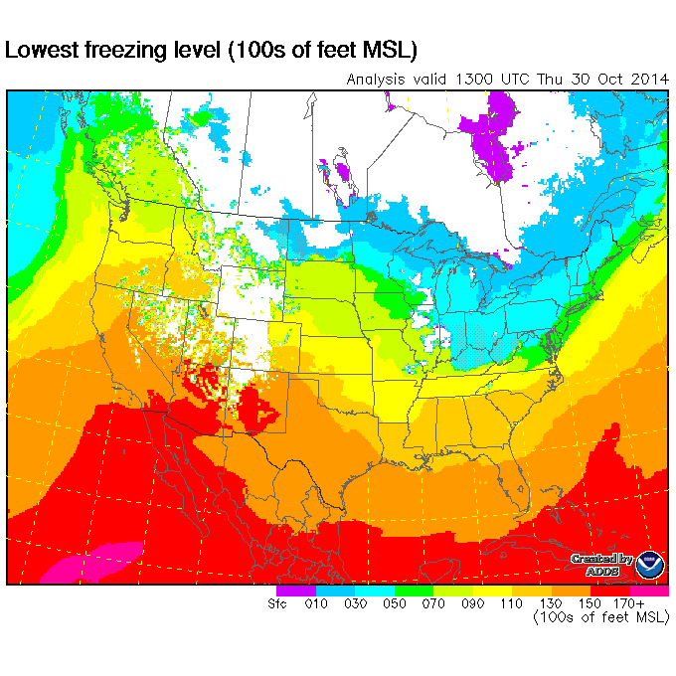
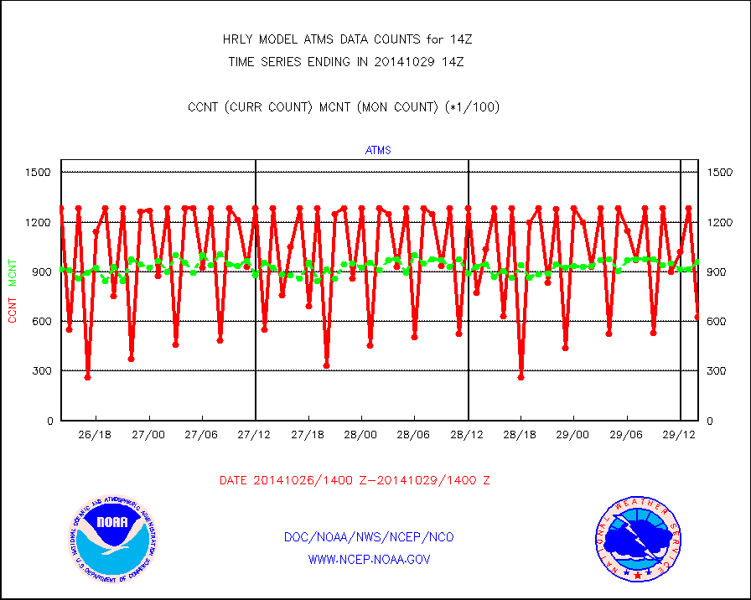
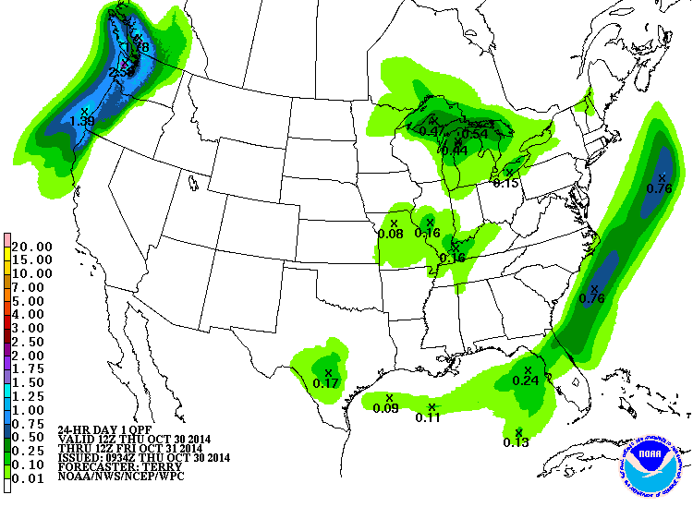
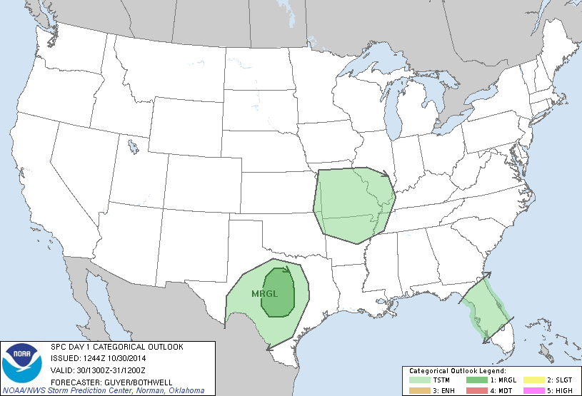
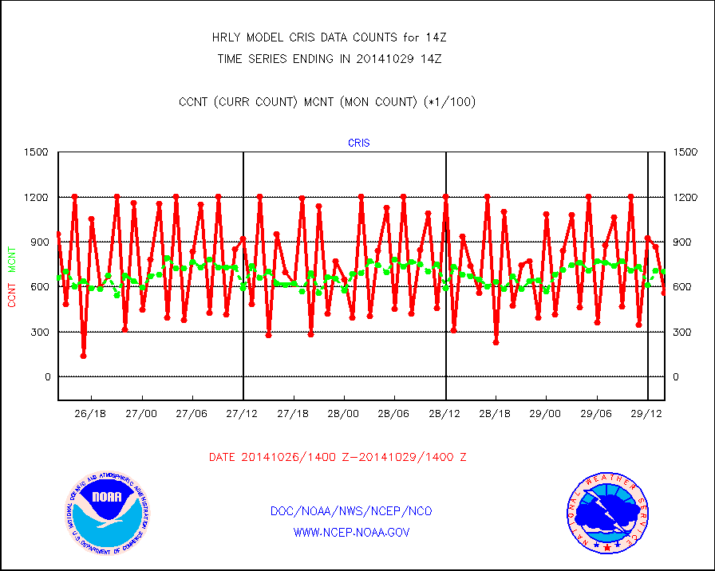
Numerical Weather Prediction – Data Assimilation (ATMS/CrIS BUFR)
Unique Products and Services
Public forecasts
Outlooks
Watches, Warnings and Advisories
Private/Government Sectors
Aviation
Energy
Environmental
Maritime
Source: NWS/NCEP
Note – NWP data assimilation involves inputs from many different sources.

Slide 11
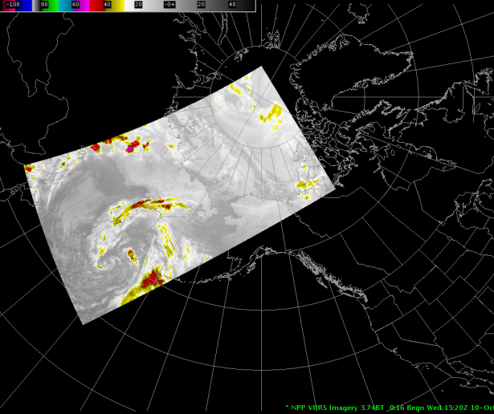
S-NPP VIIRS Imagery Over Alaskan Region
NWS is currently broadcasting VIIRS Alaska Region imagery products over its Satellite Broadcast Network (SBN) for ingest into AWIPS II
VIIRS high resolution imagery bands I01, I04 & I05 in NetCDF4
Critical Applications:
Aviation safety
Maritime safety
Public nowcasts/forecasts
Coastal/offshore forecasts
Fire weather
Ice flow monitoring
Emergency response support

Slide 12
NDE Product Tailoring Of VIIRS Imagery
National Weather Service AWIPS-II Tailored Product Granule File Sizes
VIIRS IMG EDR | IDPS | NDE Subset – lat, lon, ref | NDE Subsample – GEO lat/lon | GZIP Compression
GEO | 445 MB | 100 MB | * 130 KB
Channel 1 | 64 MB | 25 MB | 25 MB
Total | 509 MB | 125 MB (61%) | 25 MB (91%) | 13 MB (95%)
* Geolocation only uses start, mid and end point of each scan line
12

Slide 13
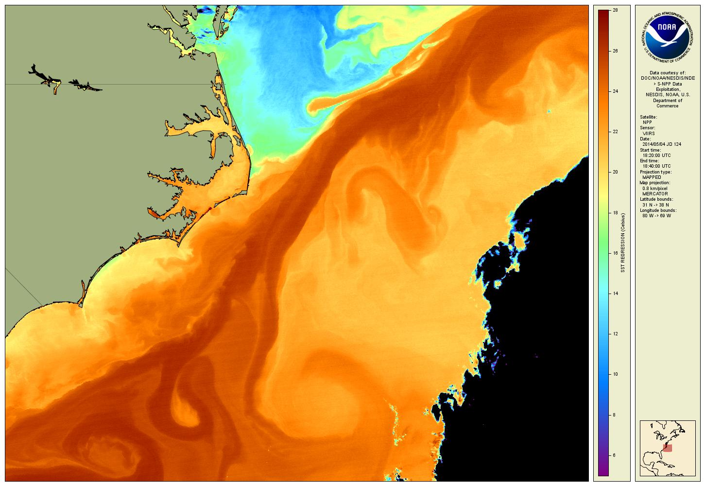
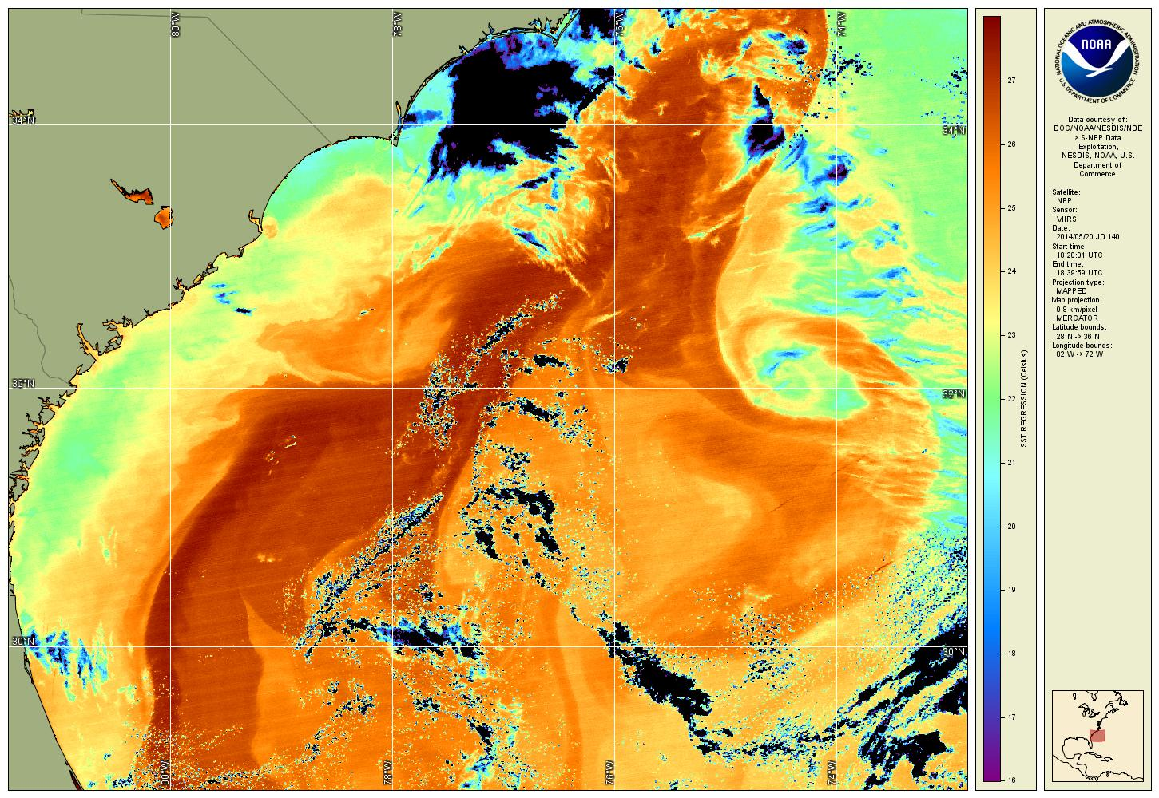
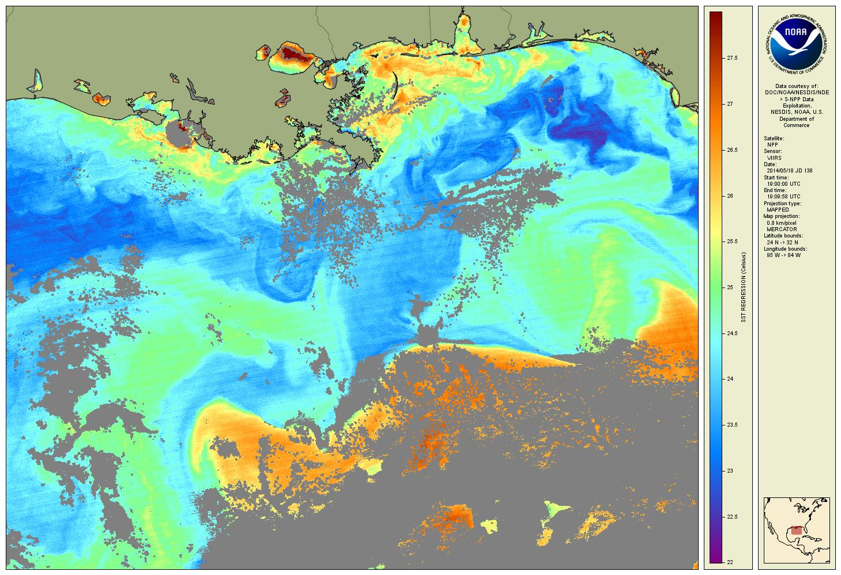
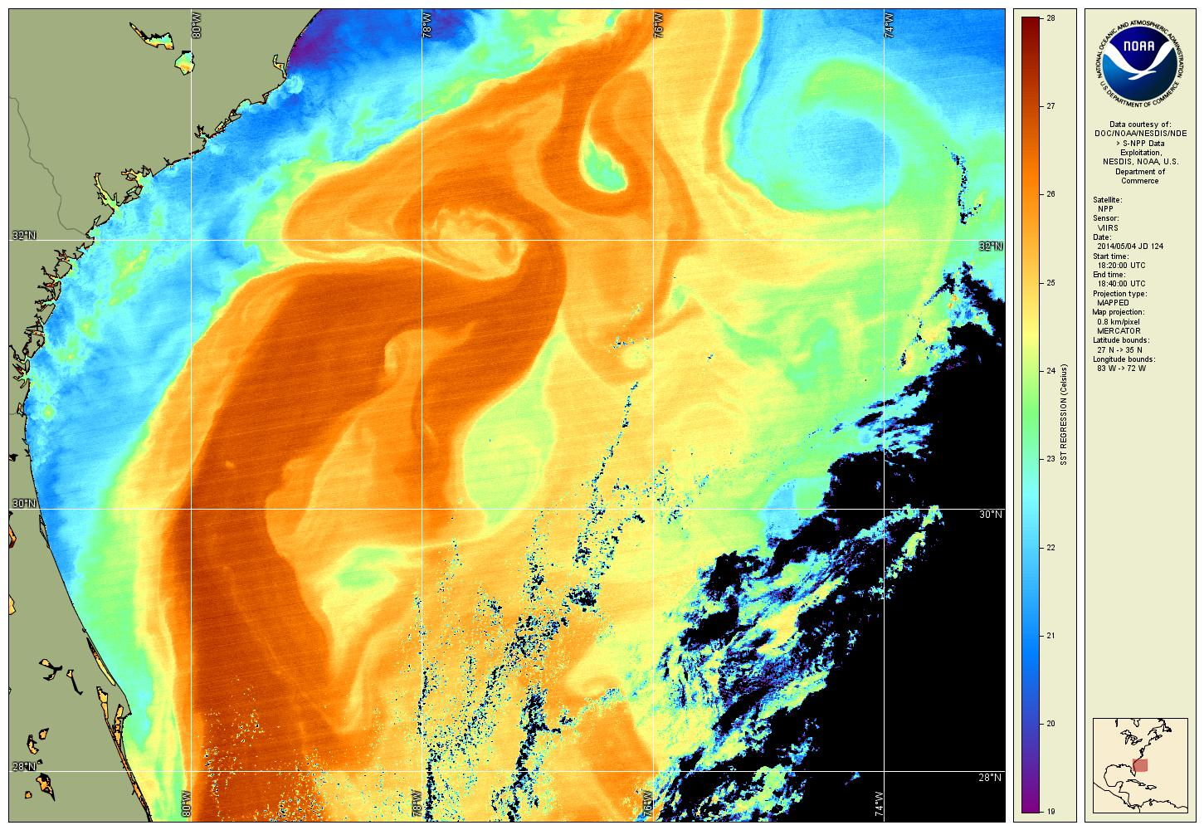
Advanced Clear-Sky Processor for Oceans (ACSPO) Sea Surface Temperature
Source: OSPO/SPSD (John Sapper)

Slide 14
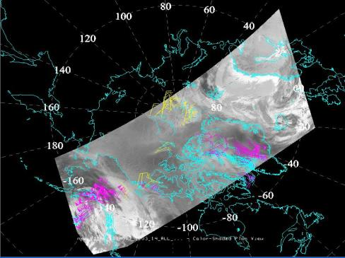
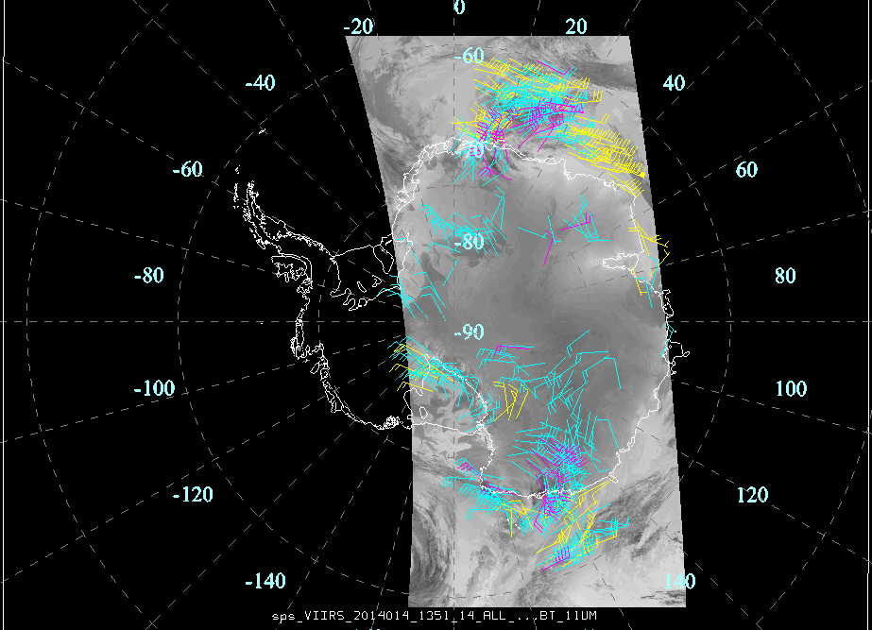
VIIRS Polar Winds (VPW) - Example
VPW Real-time Users: NWS, European/Canadian/Japanese Meteorological Centers
Other Real-time Users (3rd party relay services via EUMETcast):
UKMET Office and Norwegian Meteorological Institute
Arctic Region
Antarctic Region

Slide 15
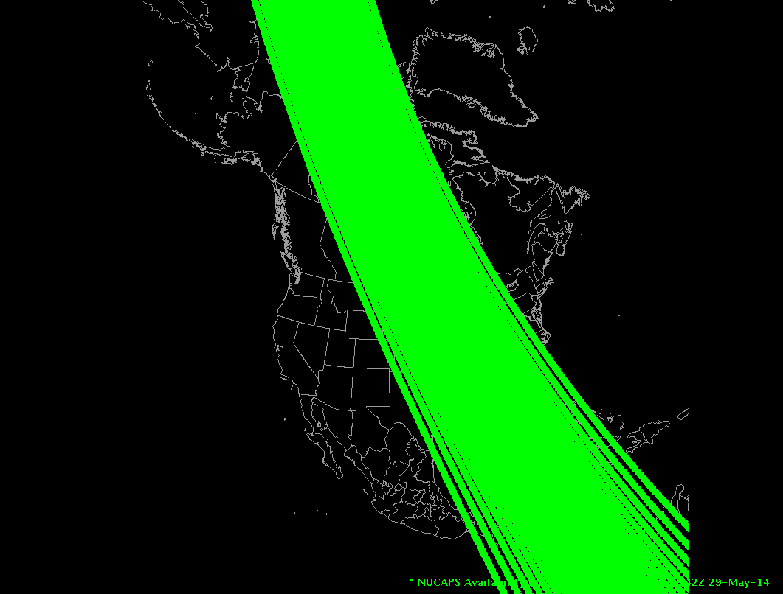
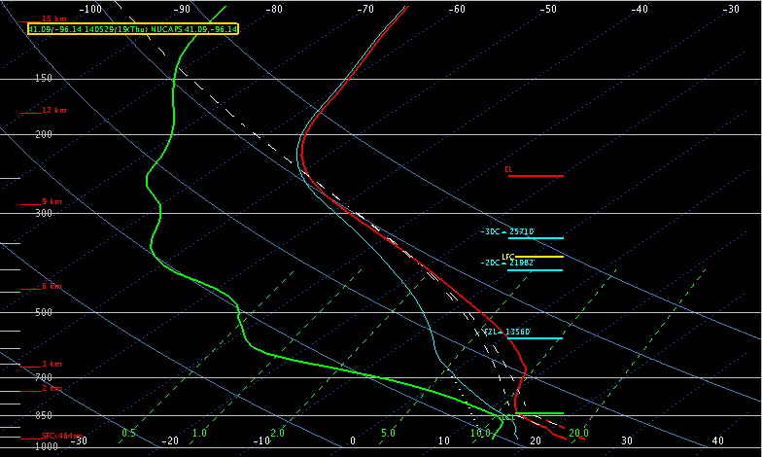
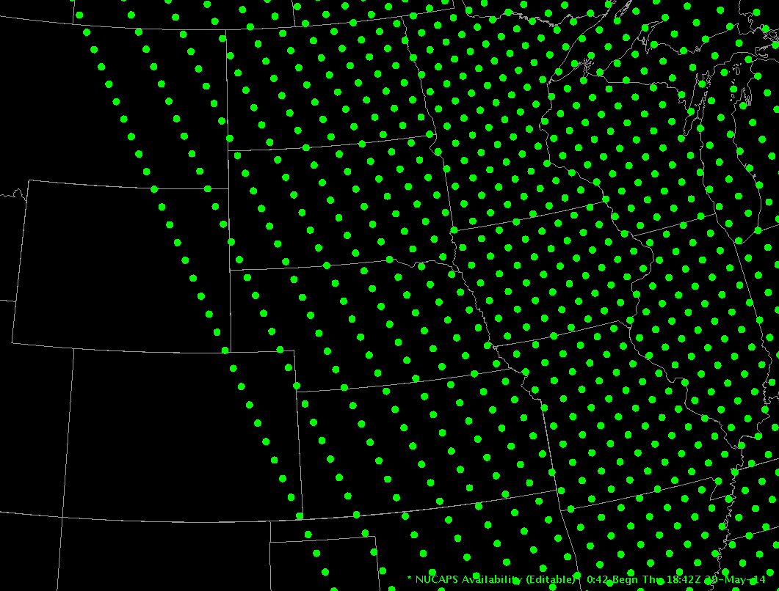
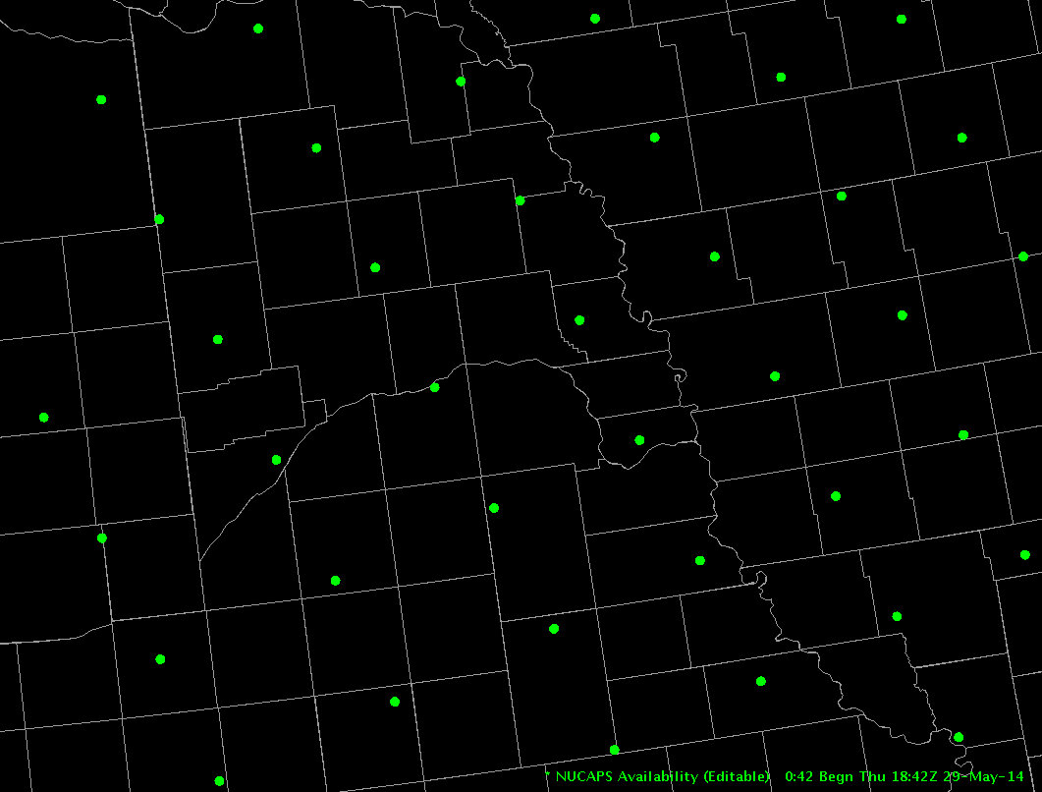
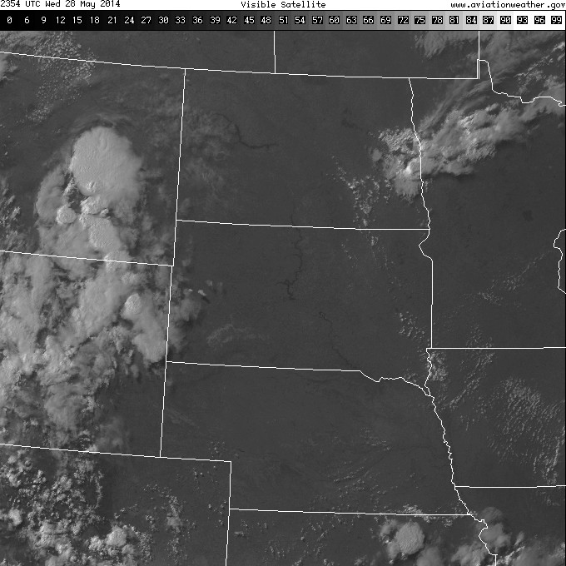
S-NPP Atmospheric Temp/Moisture Profiles
NWS Weather Field Offices are receiving (via SBN), ingesting, and displaying sounding data in AWIPS II
Data generated using the NESDIS CrIS-ATMS Algorithm Processing System (NUCAPS) algorithm
1842 UTC SNPP Pass (May 29, 2014)
T/q retrievals
Determine thermodynamics of atmosphere
Cloud heights – base/tops
Convective potential
Help diagnose precipitation types

Slide 16
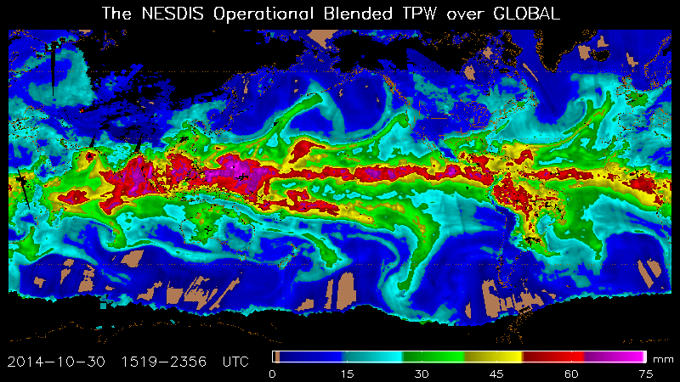
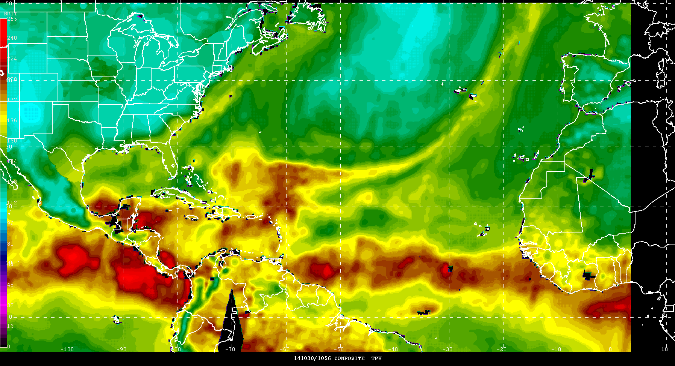
Blended Products – Total Precipitable Water (TPW)
Source: NWS National Hurricane Center (Dr. Brennan)

Slide 17
Summary
JPSS data access available through NESDIS
Near real time data from NDE and GTS
Archived data from CLASS

Slide 18
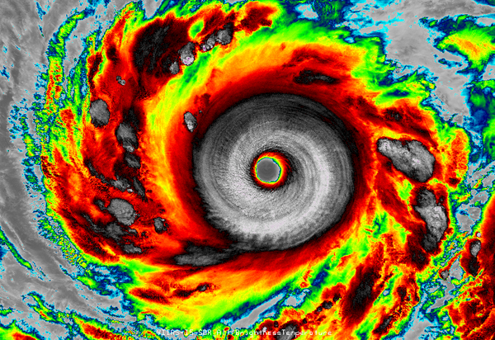
Questions
S-NPP VIIRS Image of Super Typhoon Vongfong in NW Pacific Basin (Northwest of Marianas Islands) - October 7th (courtesy of STAR/CIRA)

Slide 19
Backup Slide

Slide 20
JPSS Traceability Procedure
JPSS Level-1 Requirements
Consolidated Observation Requirements List (CORL)
NOAA User Requirement for Operations
Societal Impacts and
Support
JPSS traces these and other product requirements directly to the user community, employing vetted processes to make this connection. This procedure is as follows:
NOAA users (through their respective Line Office) formally request products through the NOAA Observing Systems Council (NOSC), having proven and vetted the product validity internally and tied it to specific societal impacts.
The NOSC allows the requirement to enter the NOAA-wide Consolidated Observation Requirements List (CORL) where it is then allocated to ANY platform or observational tool which can fulfill it.
JPSS is allocated requirements that it can fulfill from the CORL, which it is required to meet.
JPSS then engaged the Low-earth Orbiting Requirements Working Group (LORWG) to vet the current JPSS product list and rank their level of criticality to each Line Office. All feedback from the LORWG was tied directly to the JPSS allocation from the CORL.

